Slide 1
THIS IS A POWER-BI DASHBOARD THAT COVERS A ECOMMERS SALES ANALYSIS THROUGH POWER-BI DAX..
DESIGNed & ANALYSED BY
TANJU GOGOI

Slide 2
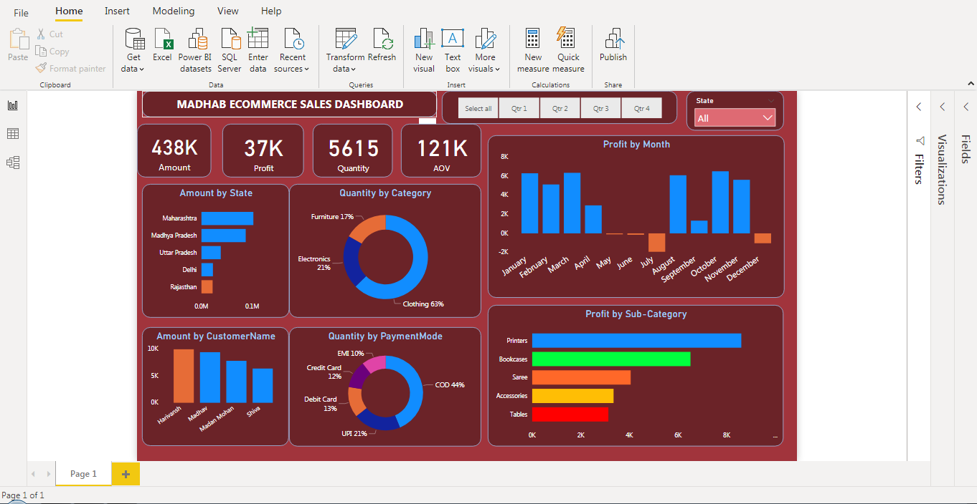

Slide 3
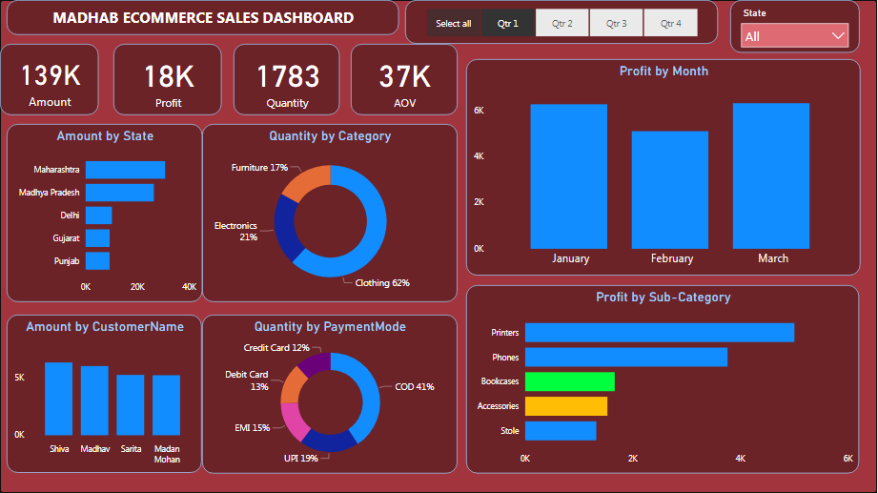
Sowing full details of Quarter-1, All States

Slide 4
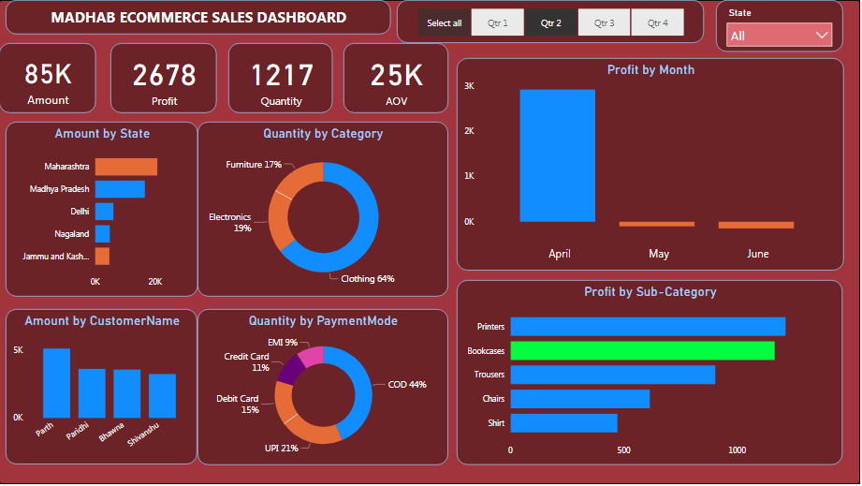
Sowing full details of Quarter-2 , All States

Slide 5
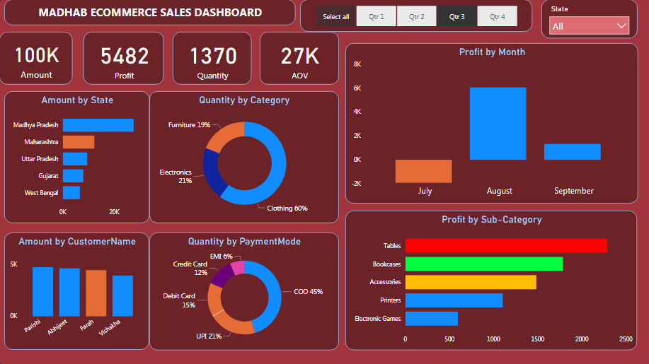
Sowing full details of Quarter-3 , All States

Slide 6
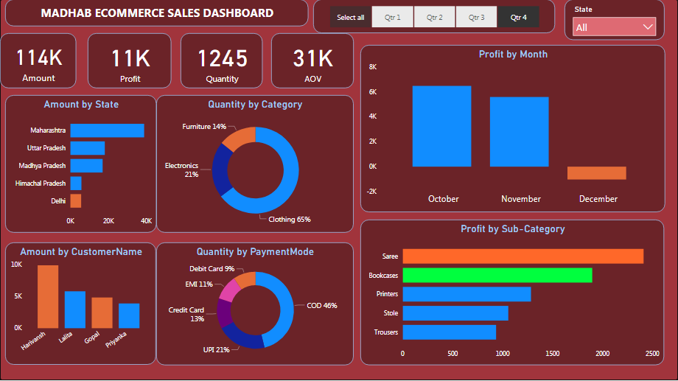
Sowing full details of Quarter-4 , All States

Slide 7
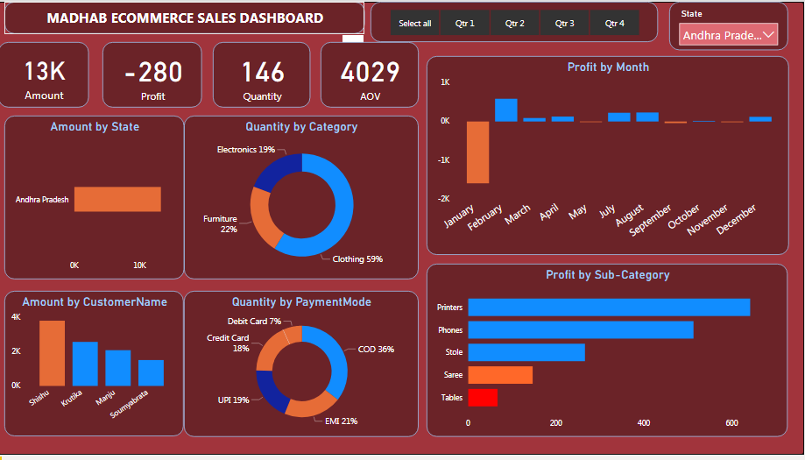
Sowing full details of All Quarters , State: Andhra Pradesh

Slide 8
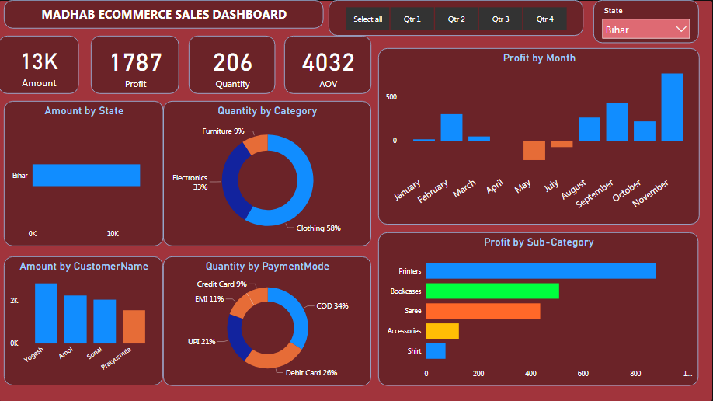
Sowing full details of All Quarters , State: Bihar

Slide 9
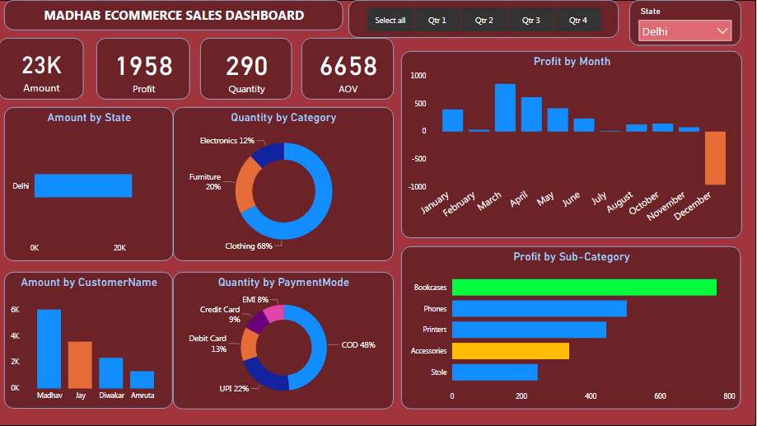
Sowing full details of All Quarters , State: Delhi

Slide 10
Conclussion:-
It will be quite long to show all details through selecting each state and quarter wise, this presentation just an example to show my skills of PowerBI..

